Slide 1
Redes Neurais Convolucionais
Isaac Sacramento
Doutorando em Ciência da Computação
Universidade Federal de Santa Catarina
Adventure Works: The ultimate source for outdoor equipment

Slide 2
Sumário
Conceitos
Deep Learning.
Redes Neurais Convolucionais
Motivação
Convolução
Downsampling
Estrutura
Principais Aplicações
Classificação.
Increased customer satisfaction.
Potêncial de aplicação em geo-estatística

Slide 3
Deep Learning
O verdadeiro desafio da IA
Resolver tarefas realizadas facilmente por pessoas, mas difíceis de serem formalizadas.
Reconhecimento de voz
Reconhecimento de faces
Aprendizado por hierarquia de conceitos
Aprendizado de conceitos complicados a partir de conceitos simples

Slide 4
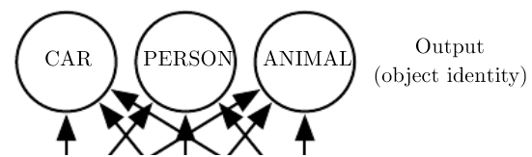
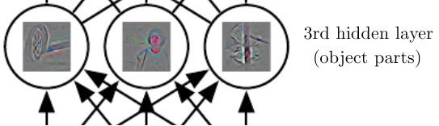

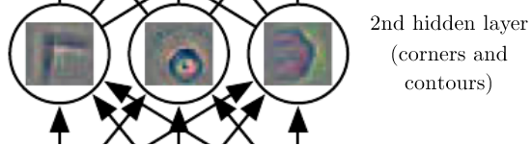
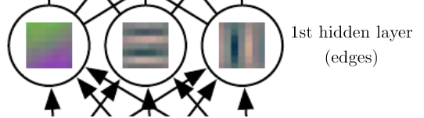

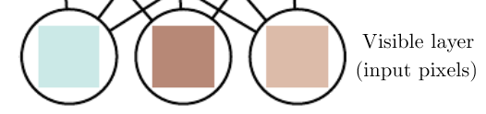
Deep Learning

Slide 5
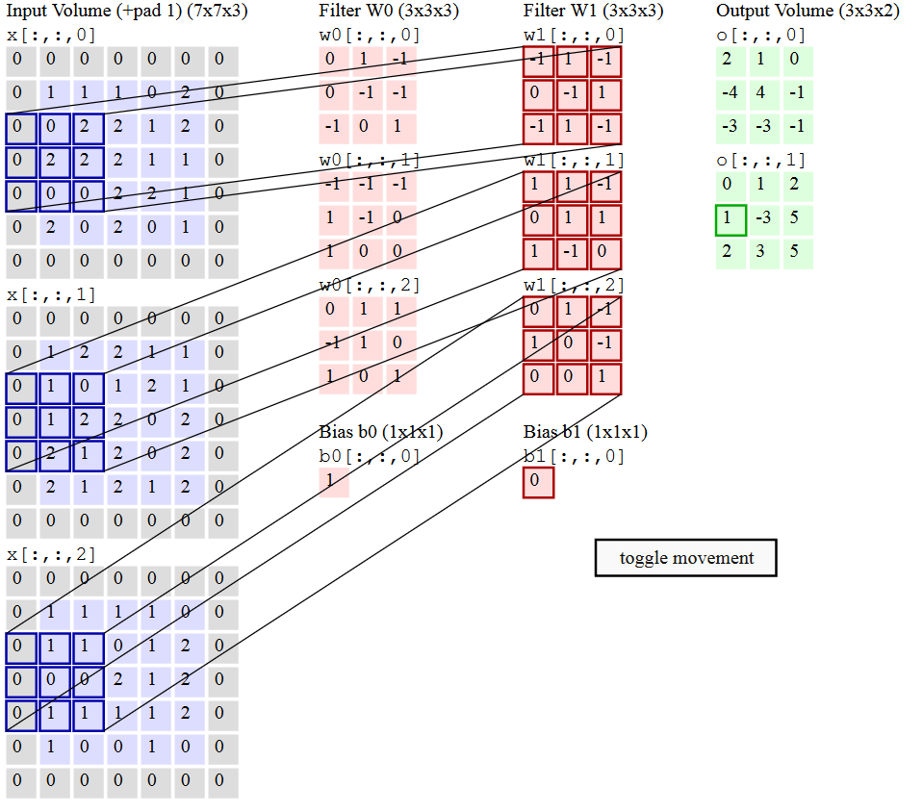
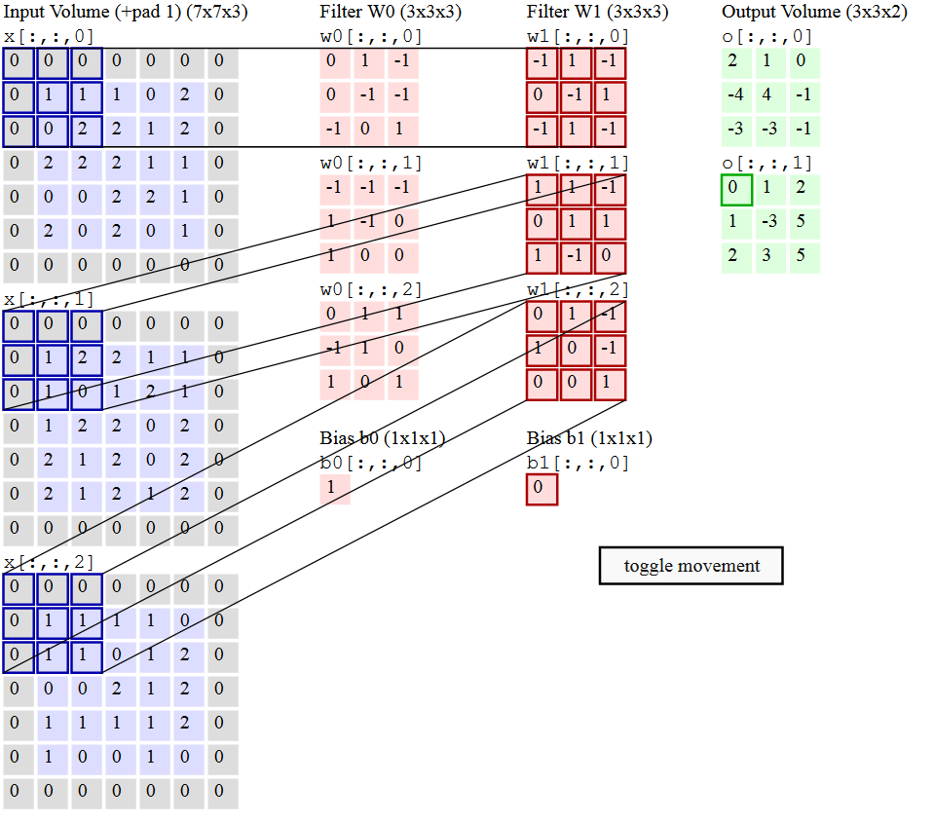
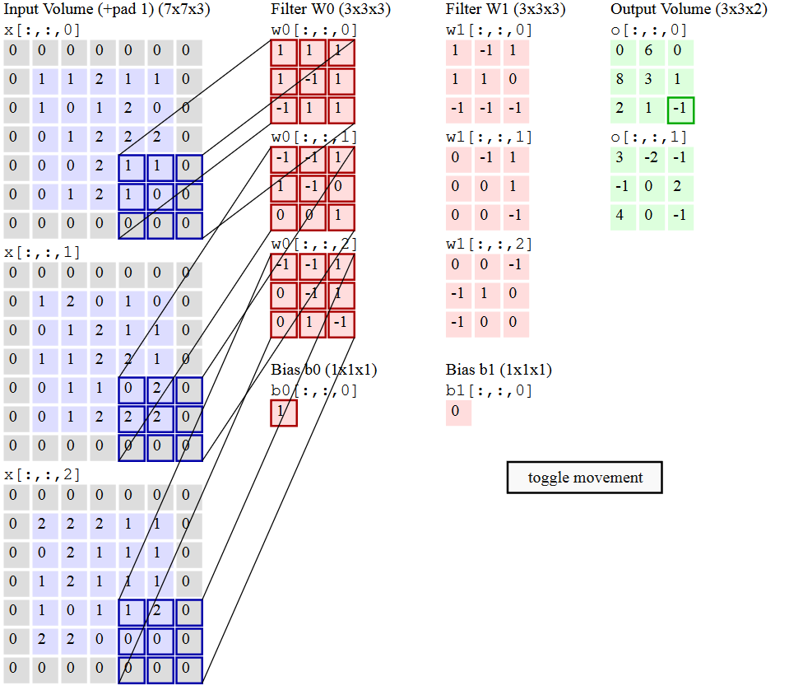
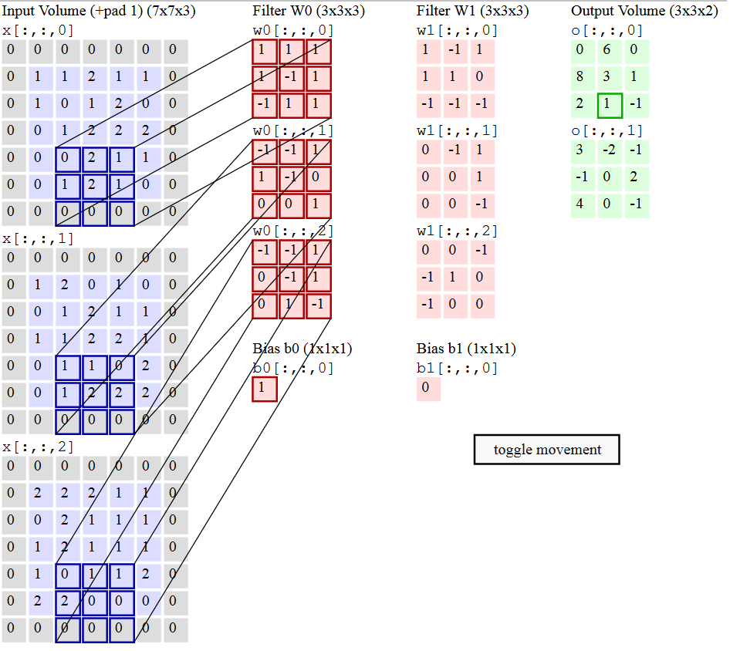
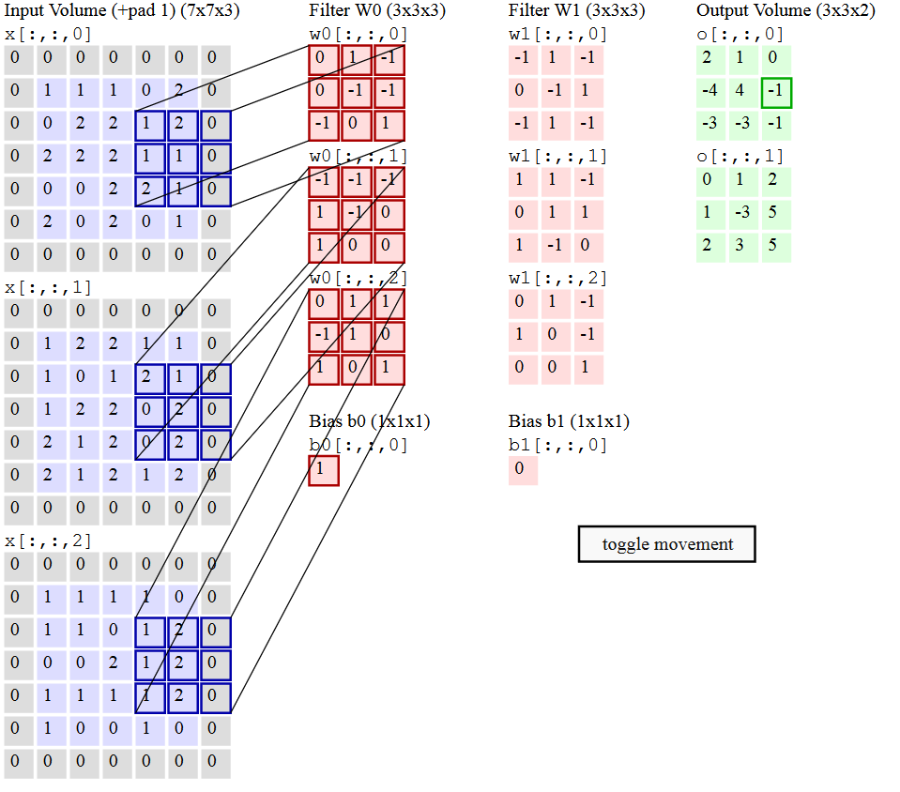
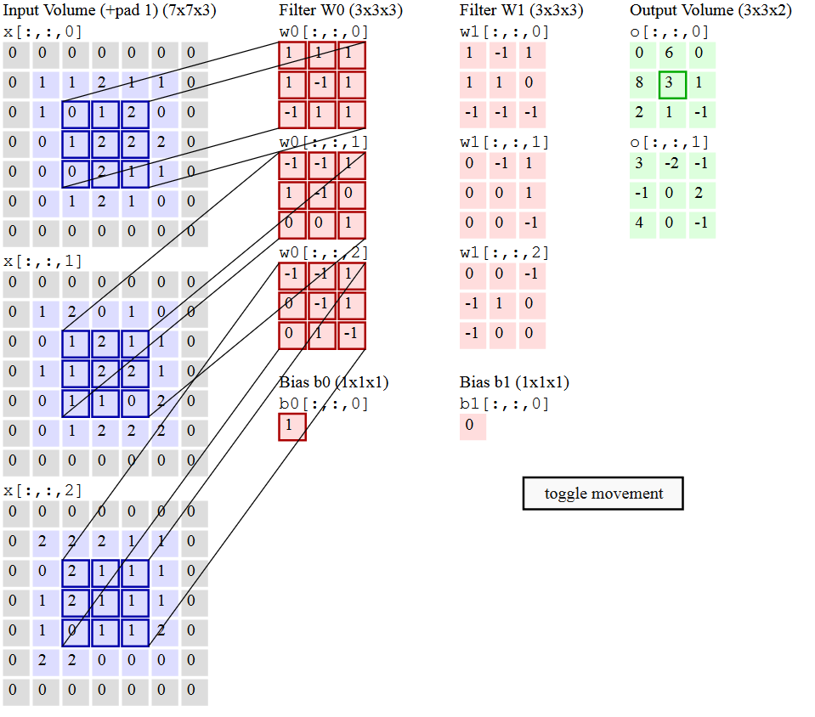
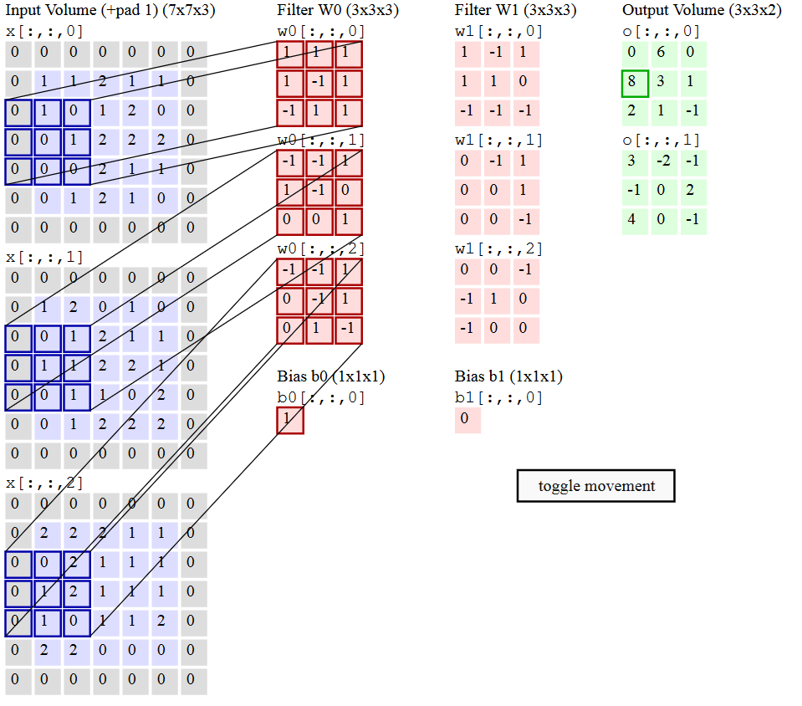
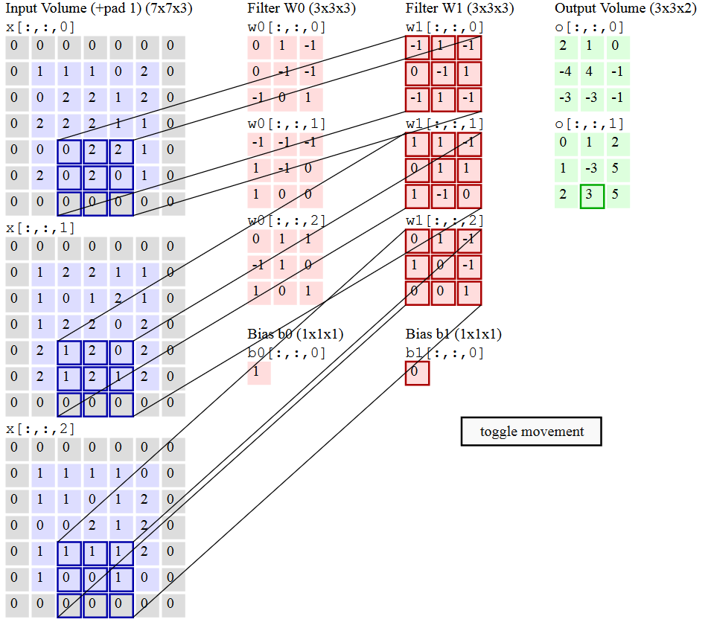
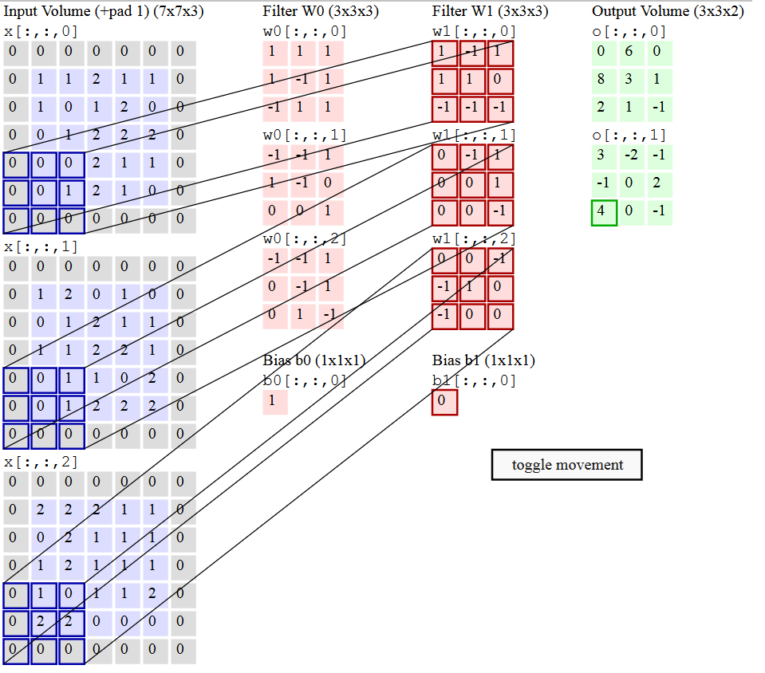
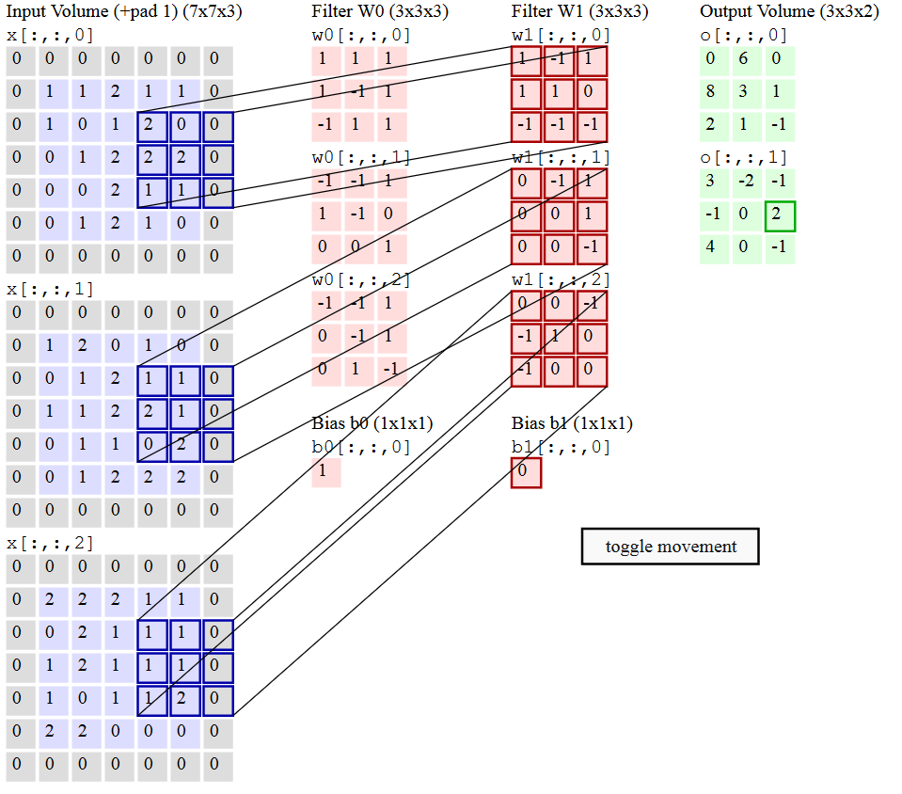
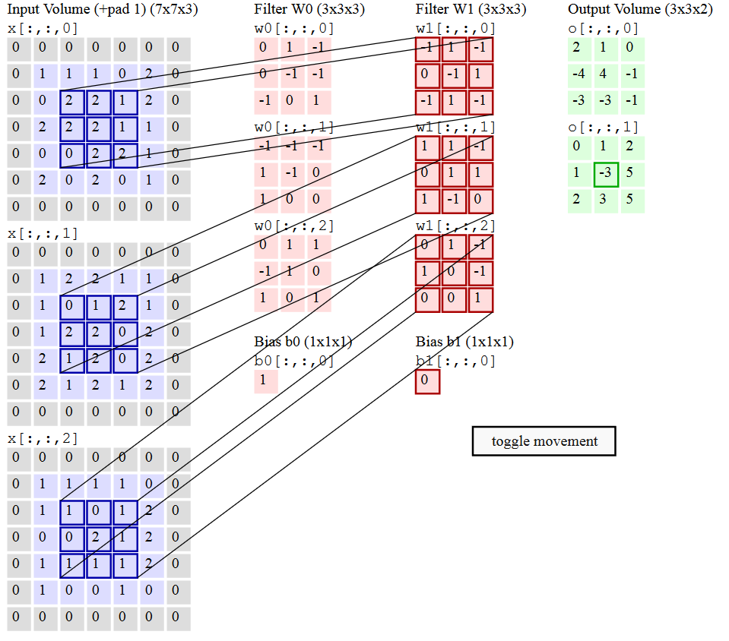
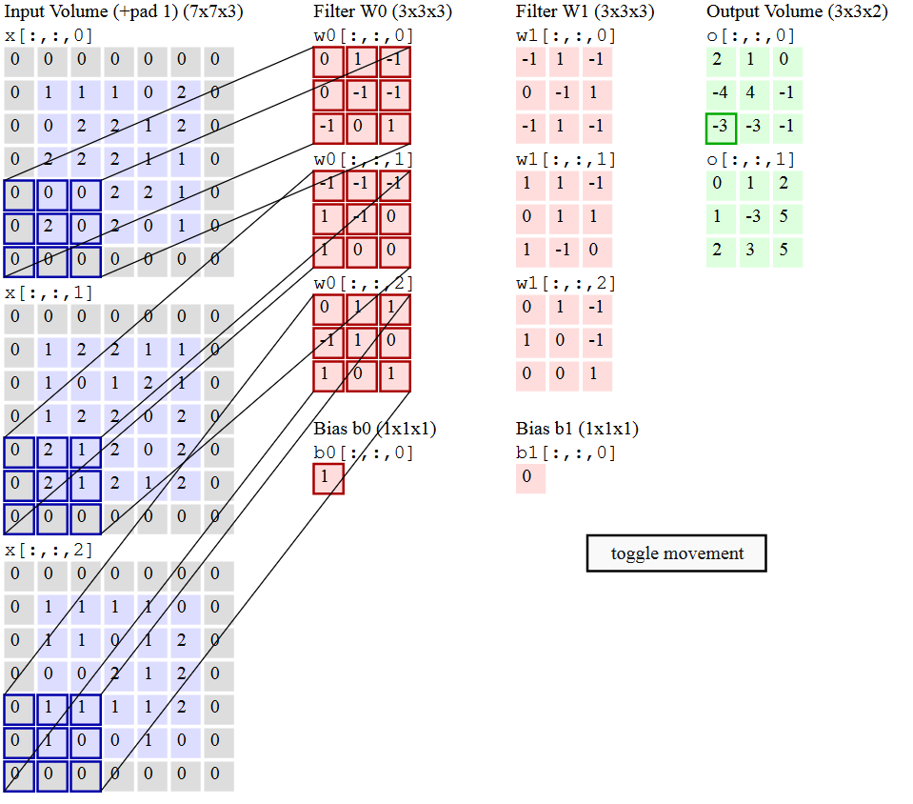
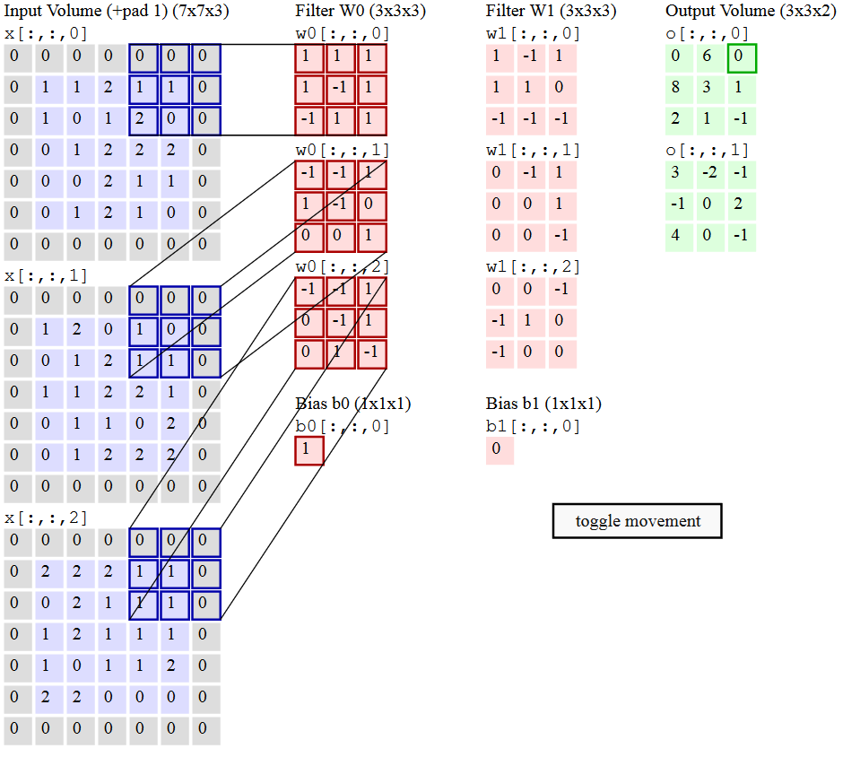
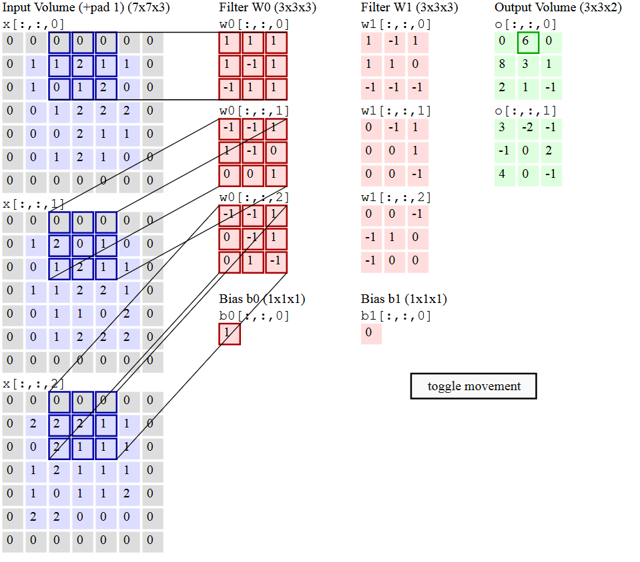
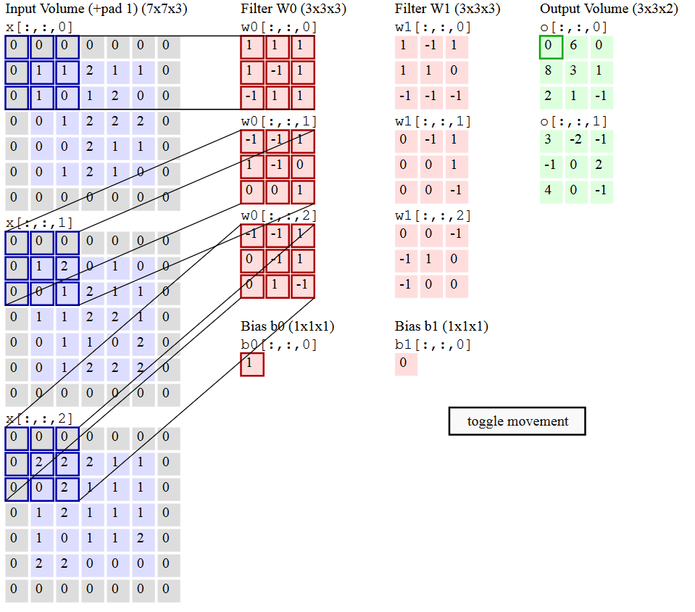
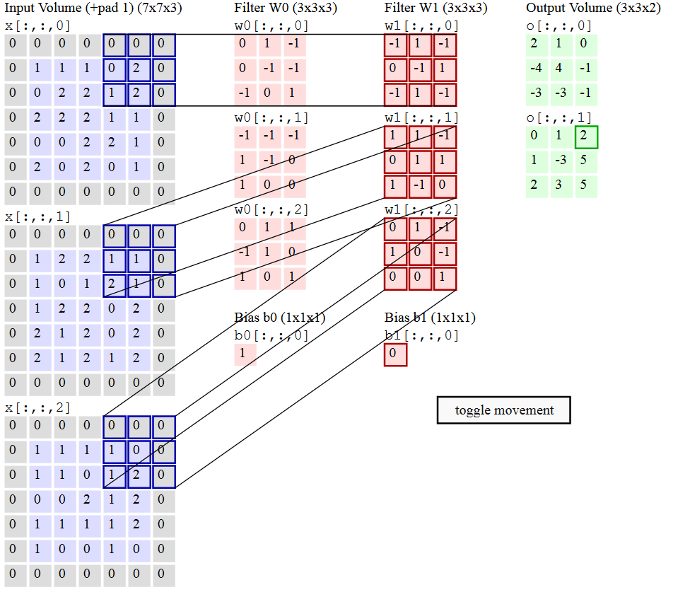
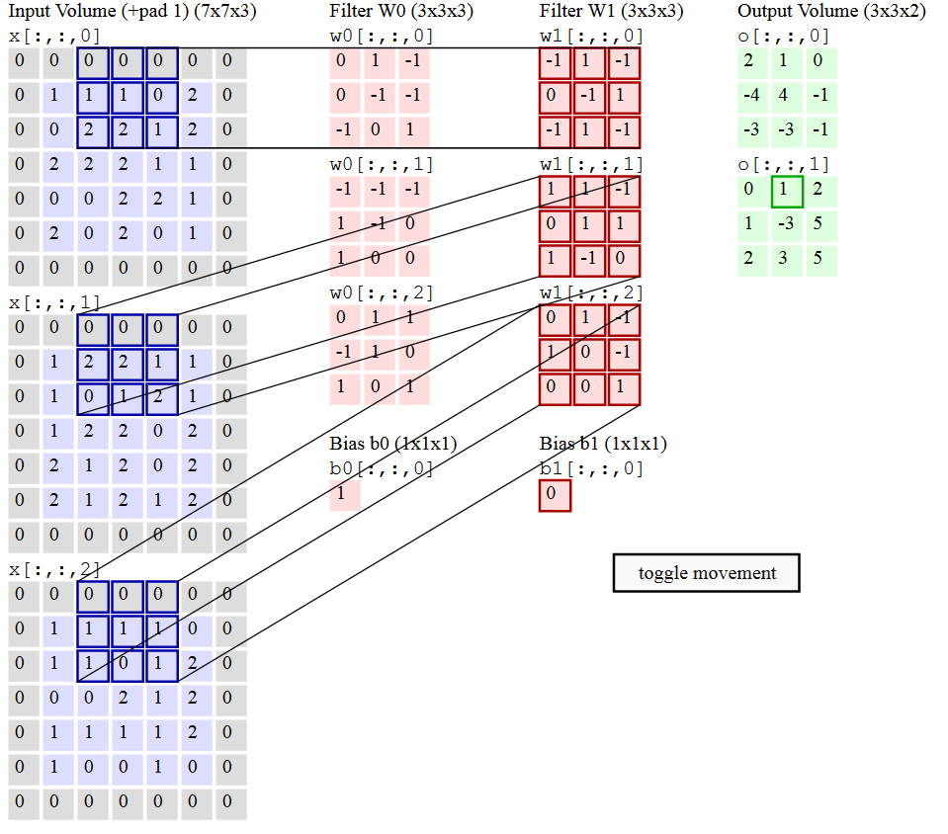
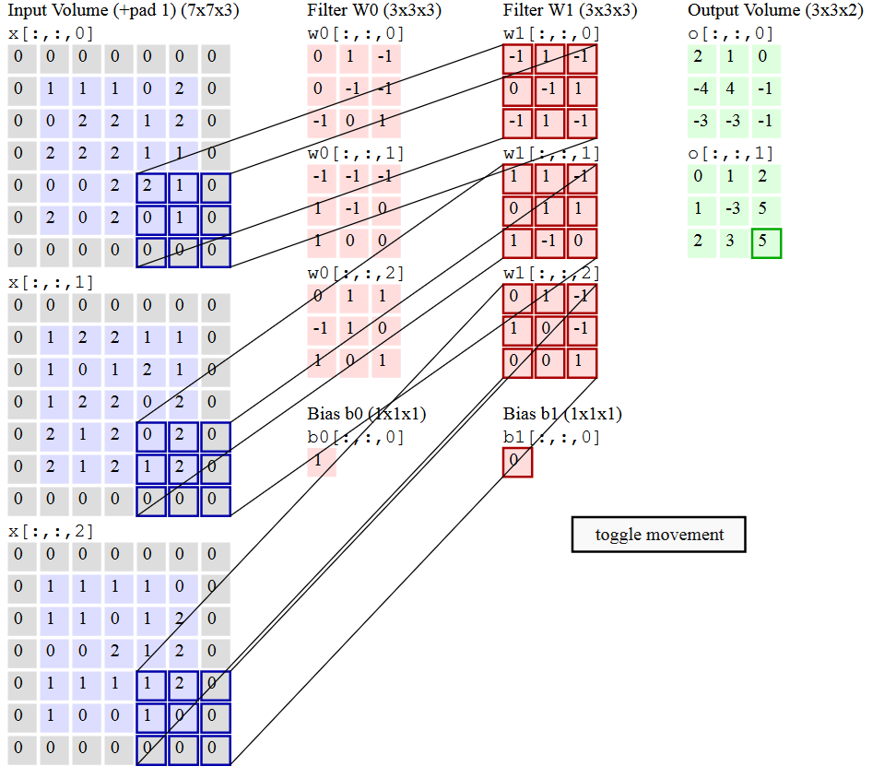
Convolução

Slide 6
Proposed New Products
Survival gear
Sportswear
Outerwear
Off-road bicycles
Fishing equipment and tackle
Canoes and personal rowing shells

Slide 7
Costs of Return on Investment Projections
Costs
ROI

Slide 8
Terms and Conditions
Terms and conditions #1
Terms and conditions #2
Terms and conditions #3
Terms and conditions #4
Terms and conditions #5

Slide 9
Strategy and Schedule
Strategy
Tactic #1
Tactic #2
Tactic #3
Schedule
Adopt plan
3Q [Year]
Implement
4Q [Year]
Evaluate
3Q [Year]
Adjust
4Q [Year]

Slide 10
Sales and Marketing Needs
Close sales faster.
Present complex concepts quickly and clearly.
Leverage database information (sales numbers, customer locations, etc.).

Slide 11
Close Sales Faster
Need and solution #1
Need and solution #2
Need and solution #3
Need and solution #4
Need and solution #5

Slide 12
Present Complex Concepts Quickly and Clearly
Need and solution #1
Need and solution #2
Need and solution #3
Need and solution #4
Need and solution #5

Slide 13
Leverage Database Information
Need and solution #1
Need and solution #2
Need and solution #3
Need and solution #4
Need and solution #5

Slide 14
Questions and Answers

Slide 15
Adventure Works: The ultimate source for outdoor equipment

